Slide 1
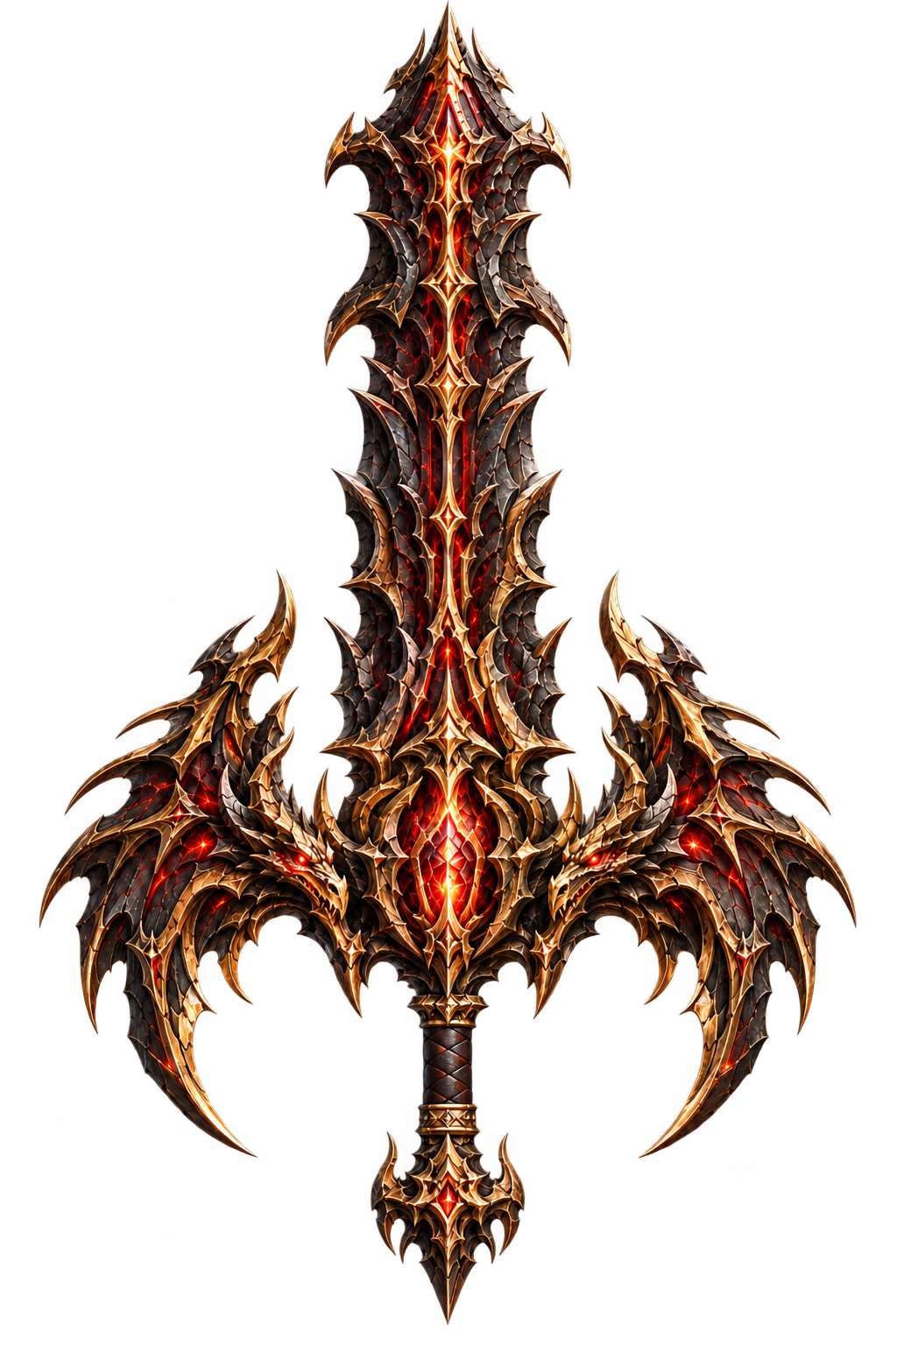
A TEST GAME ON SEPOLIA
Forge
of Fate
A 3D game where you upgrade weapons,
turn them into NFTs and earn game gold.
Project demo
Notes:
Timing: about 25 seconds.
Hi everyone. This is our game, Forge of Fate. You start with a sword and try to make it stronger in a 3D workshop. Later, you can turn it into an NFT, sell it, or stake it to earn game gold. The blockchain features run on Sepolia.
Sources: README.md, current functionality and NFT rules, updated 2026-11-02. Original visual: assets/display/Greatsword/+60Greatsword.png.

Slide 2
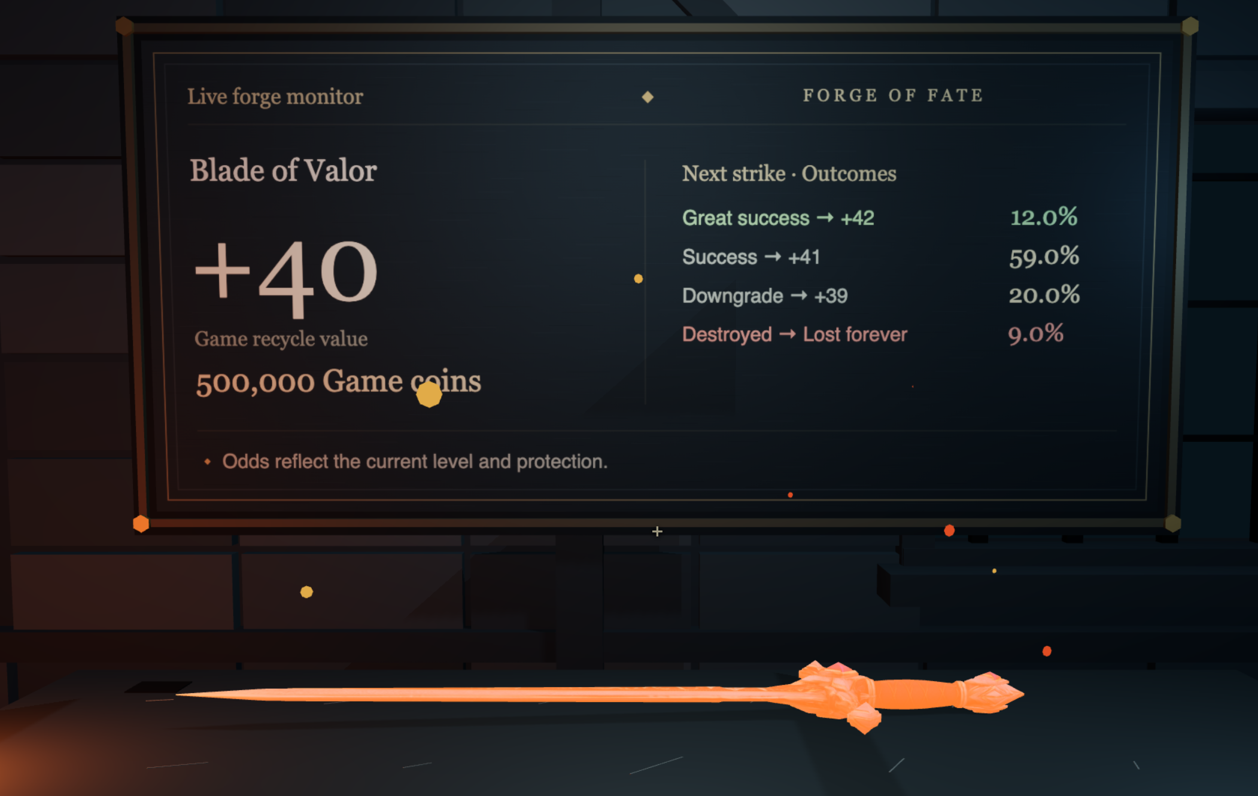
How to play
Heat the sword, then hit it
Each hit can raise the level,
lower it, or break the weapon.
Three weapon types
At +5: 30% chance of a Rapier.
If it stays a Knight Sword:
at +10, 30% chance of a Greatsword.
Jumping past a level still counts. Losing levels won’t give you another try.
02
Notes:
Timing: about 25 seconds.
To play, you heat the sword in the furnace and hit it on the anvil. Each hit can raise its level, lower it, or break it. The screen shows the chances before you hit. As the sword levels up, its look can change too. That brings us to the three weapon types.
Sources: README.md and backend/balance.json. Screenshot: .local/presentation-capture/workshop-english-active.png, captured from the current game in an isolated local environment on 2026-11-02. The scene shows a heated level 40 Knight Sword with sufficient materials and active controls. The capture does not use Infura or the user’s live account.

Slide 3
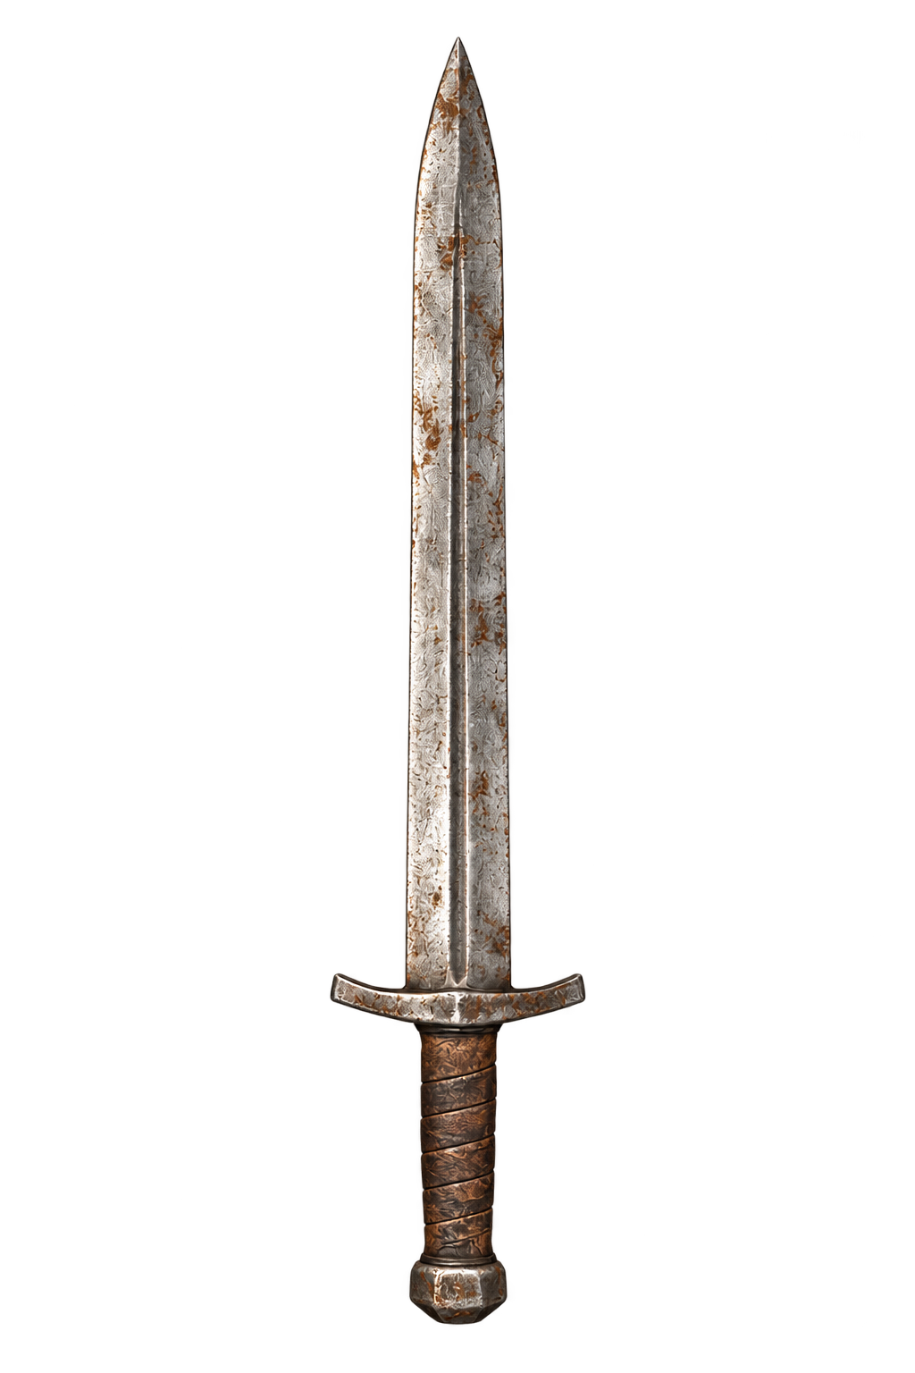
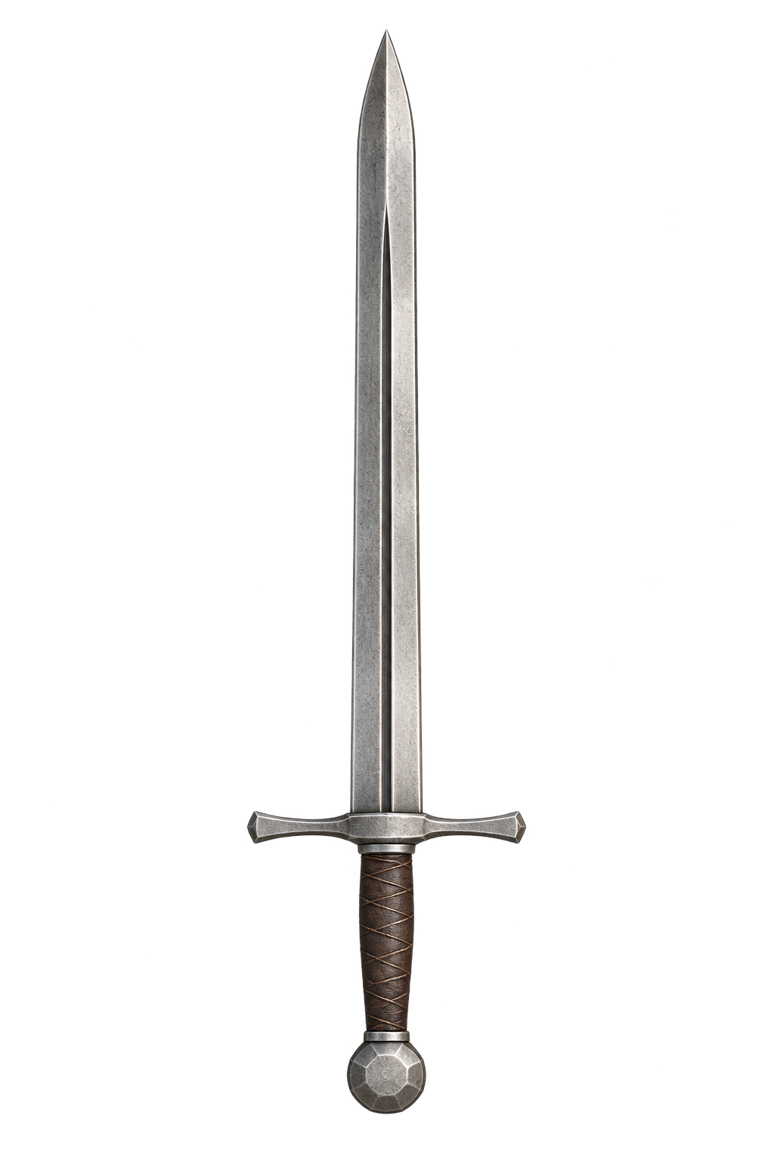
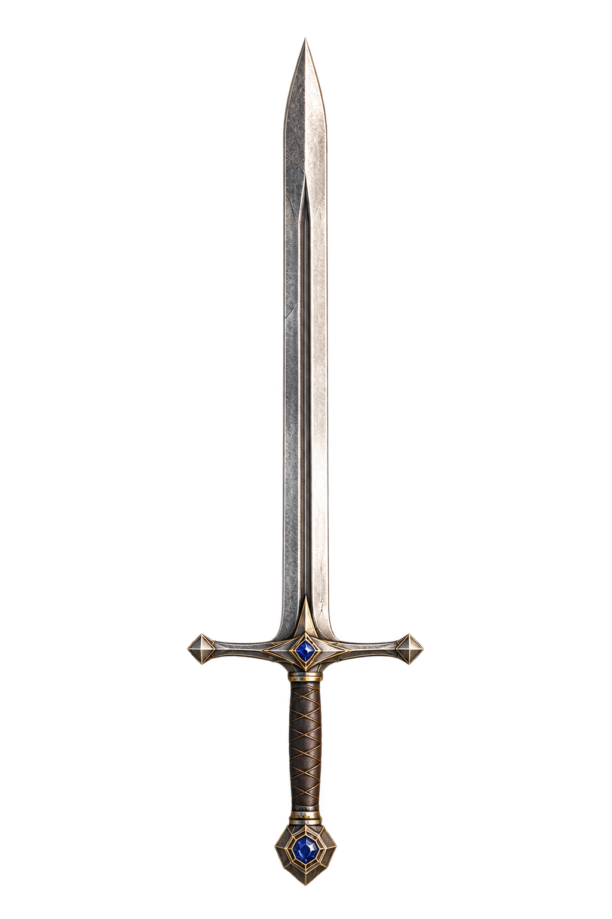
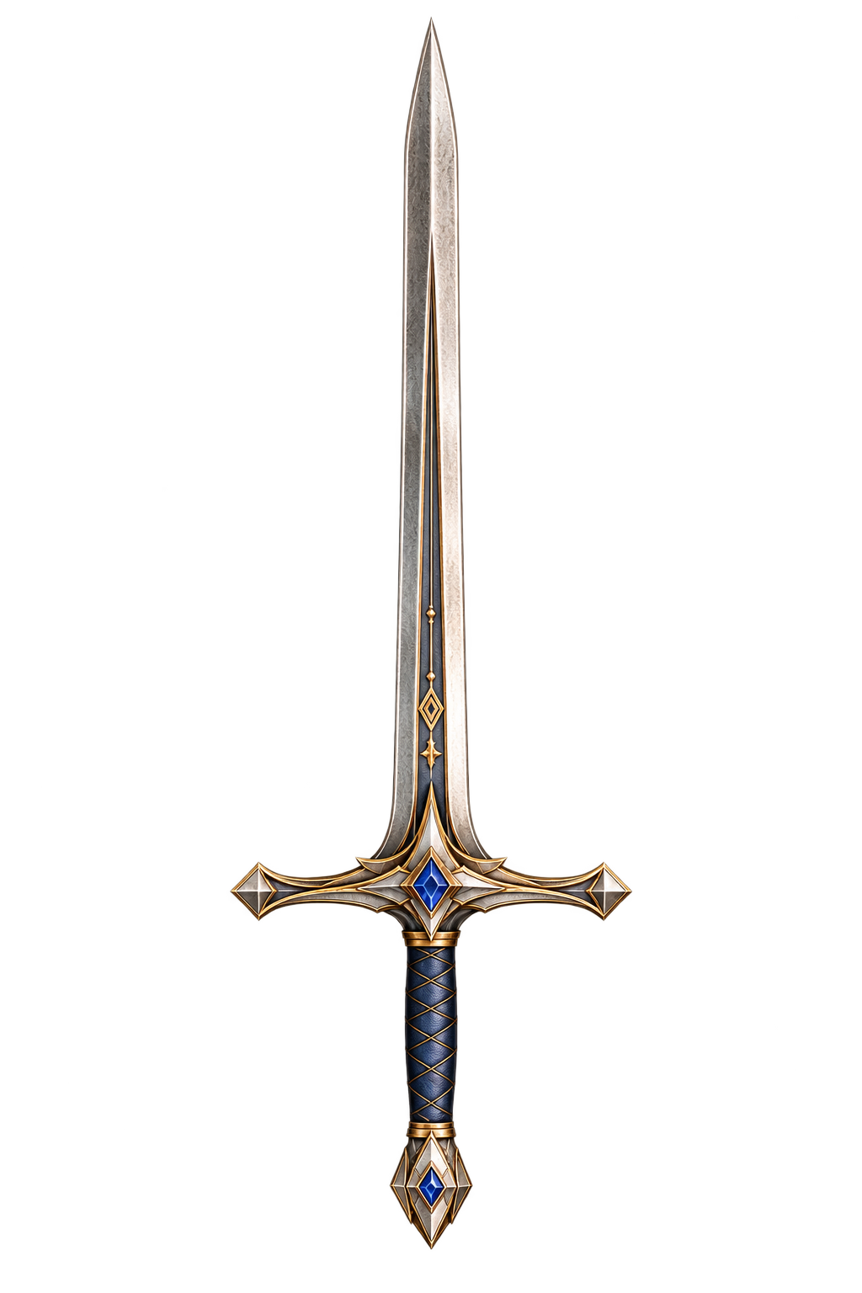
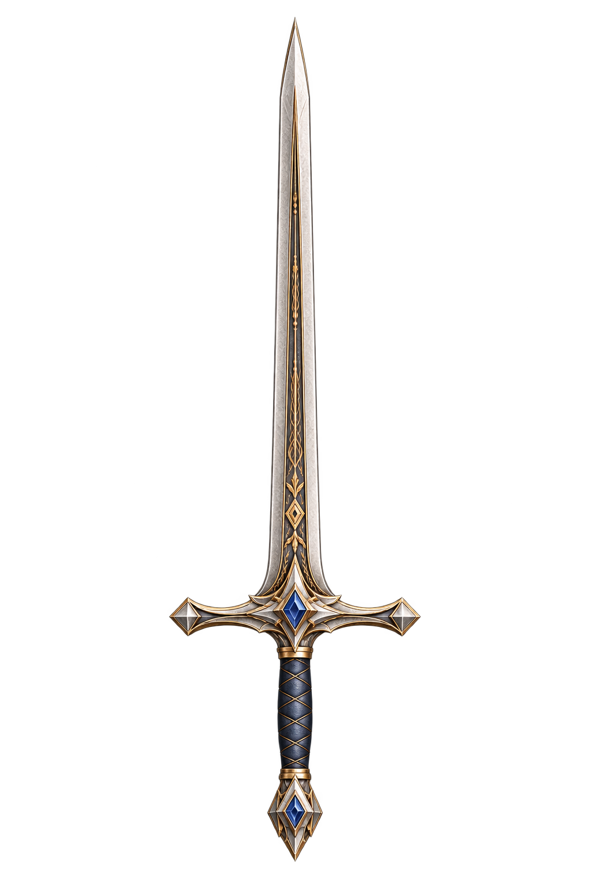
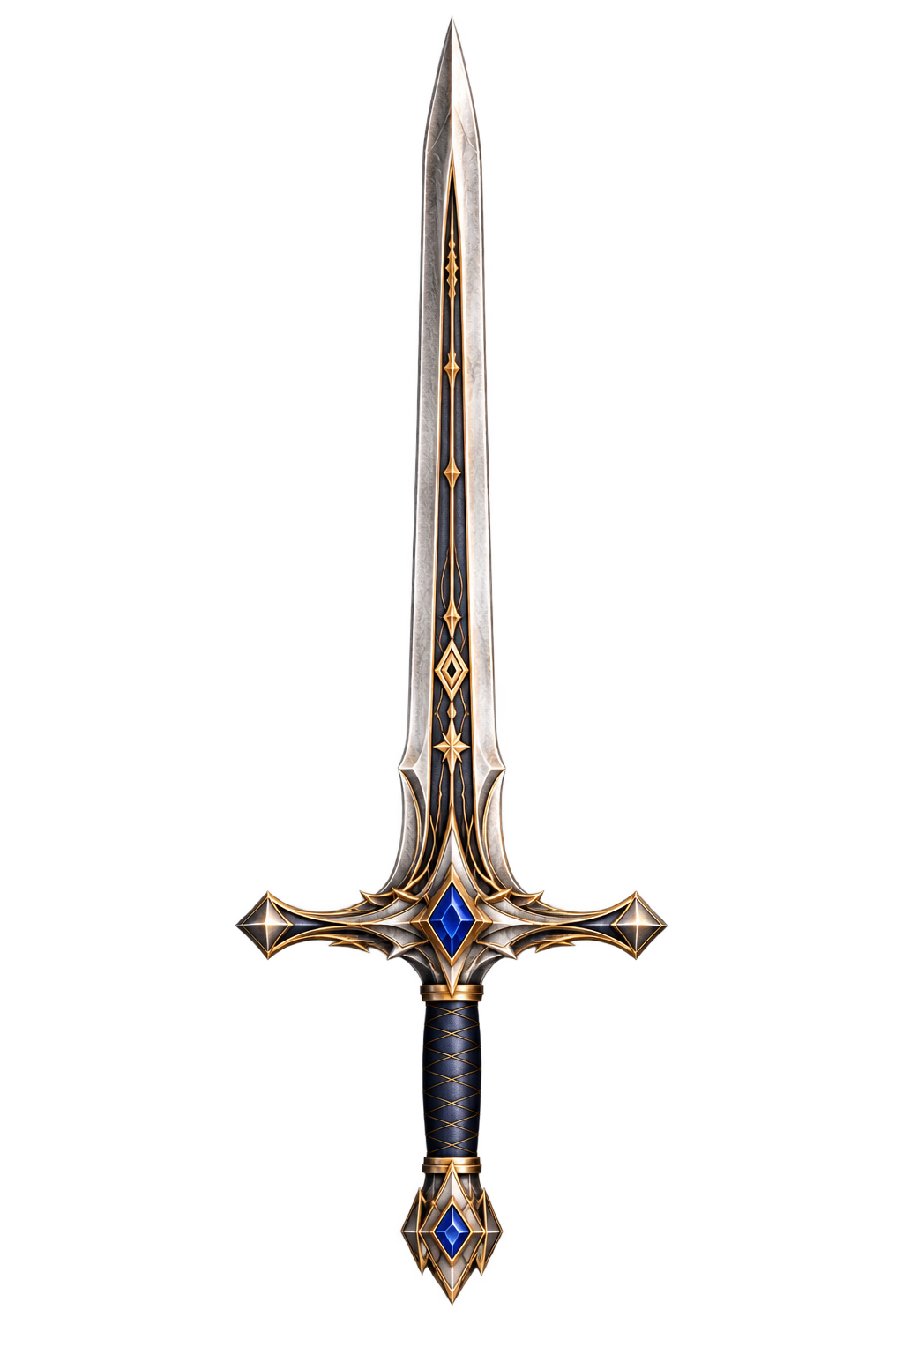
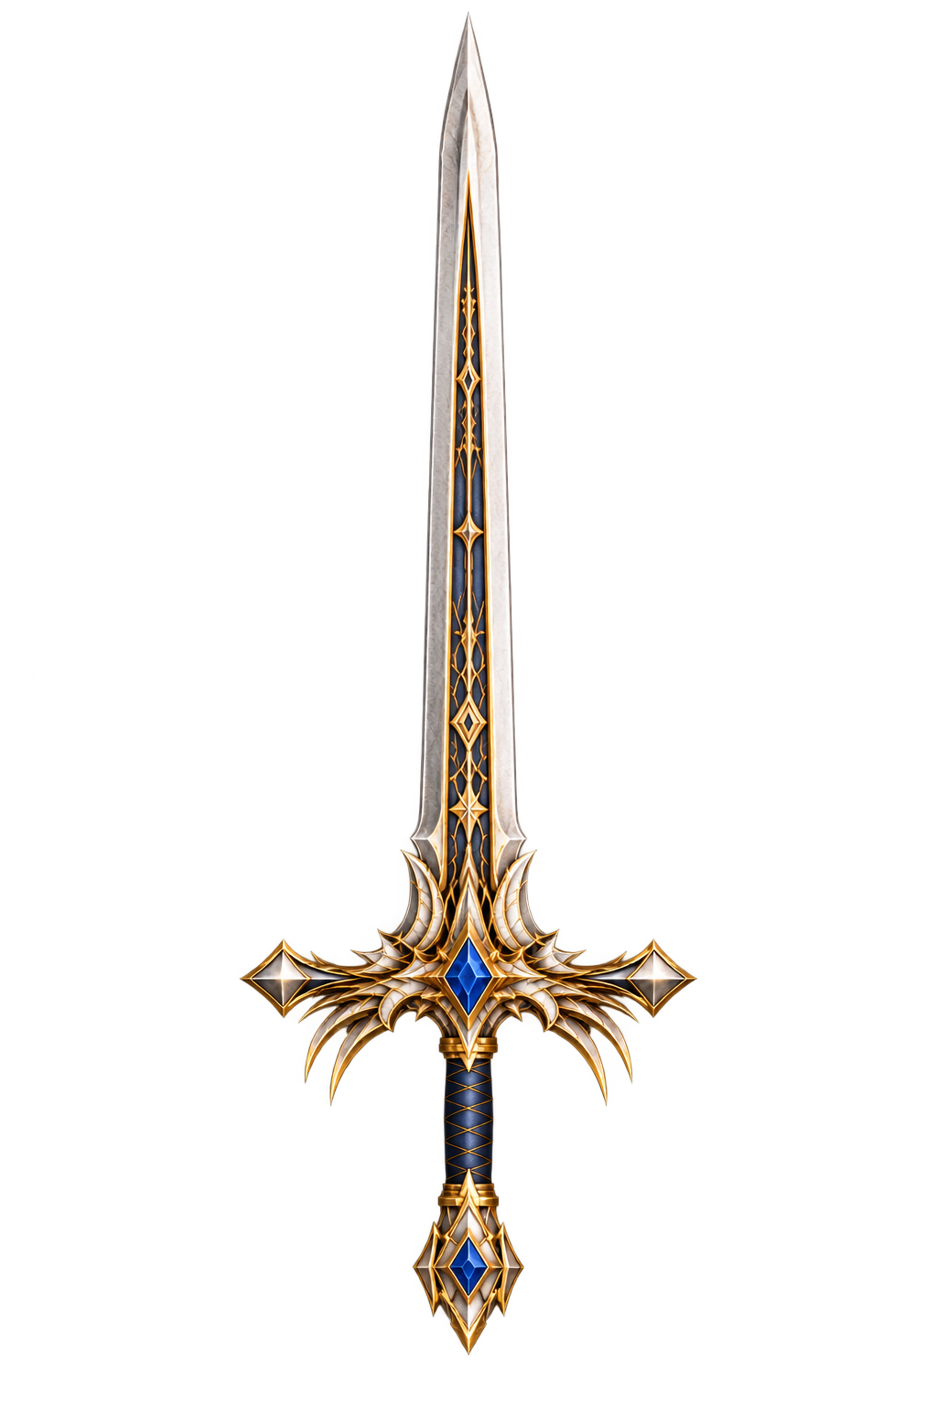
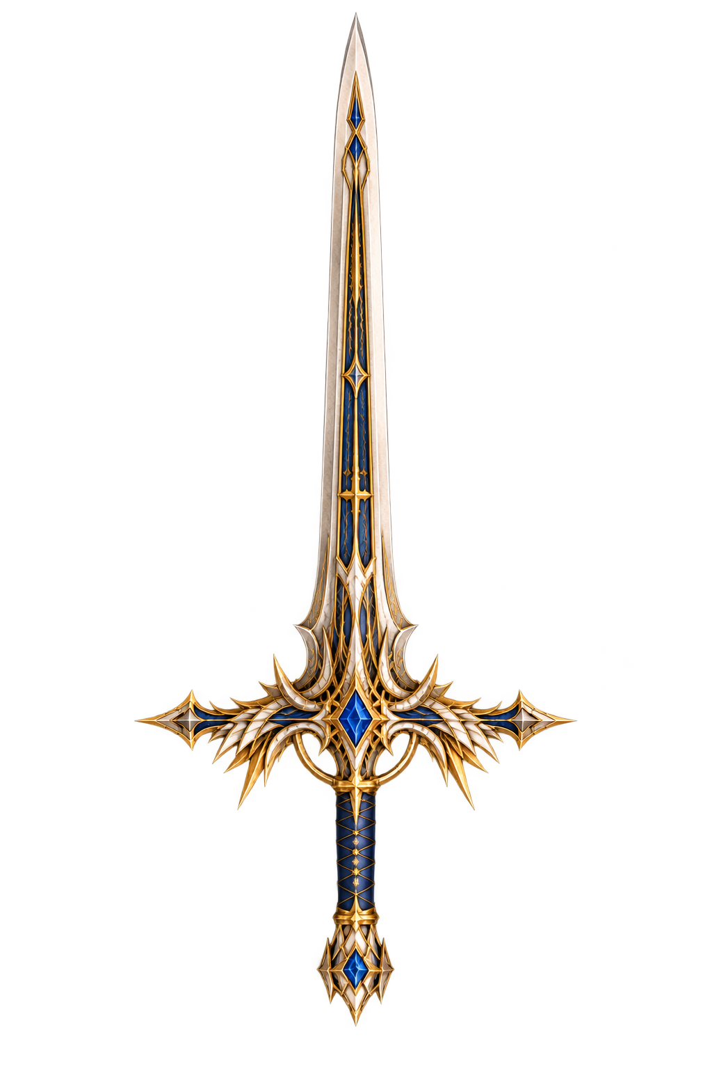
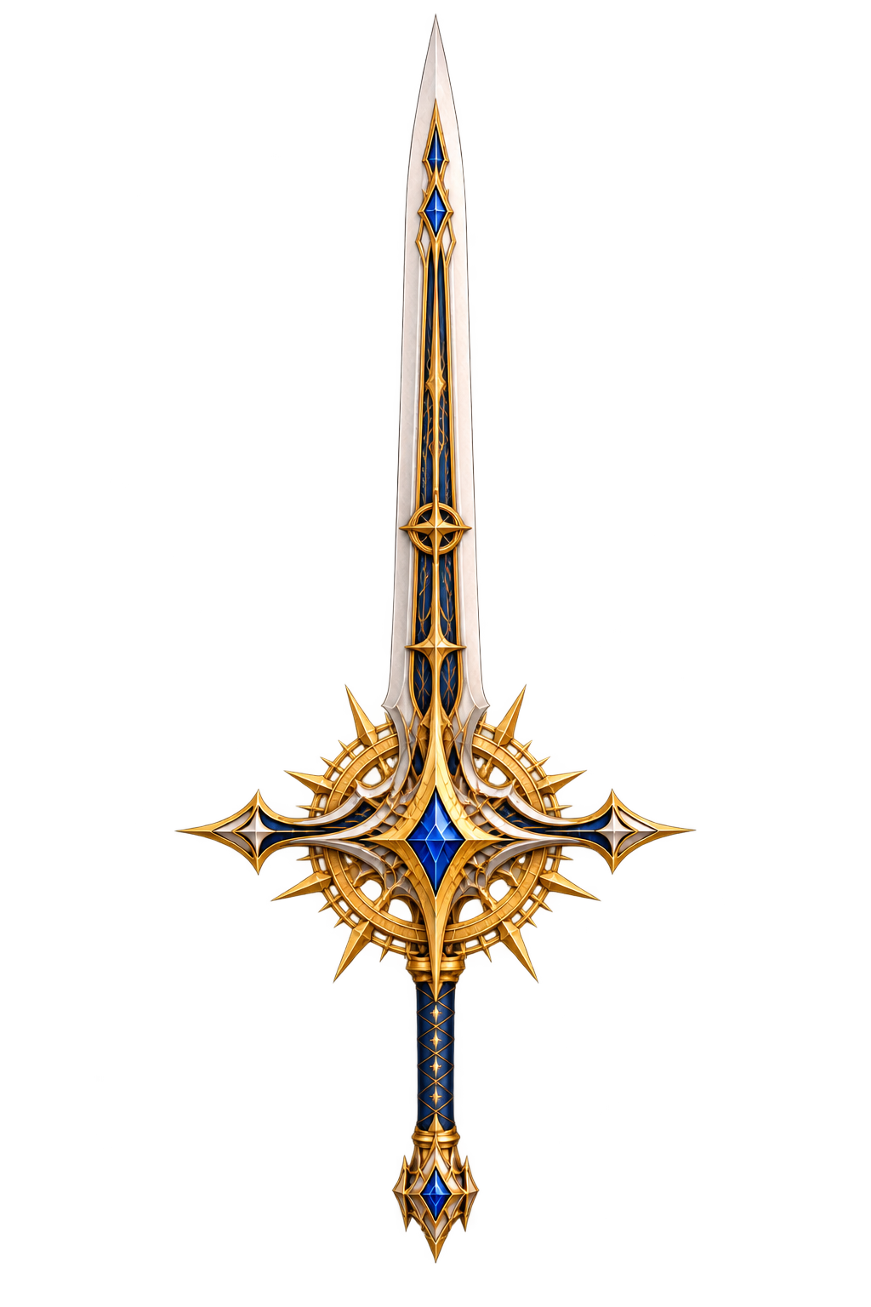
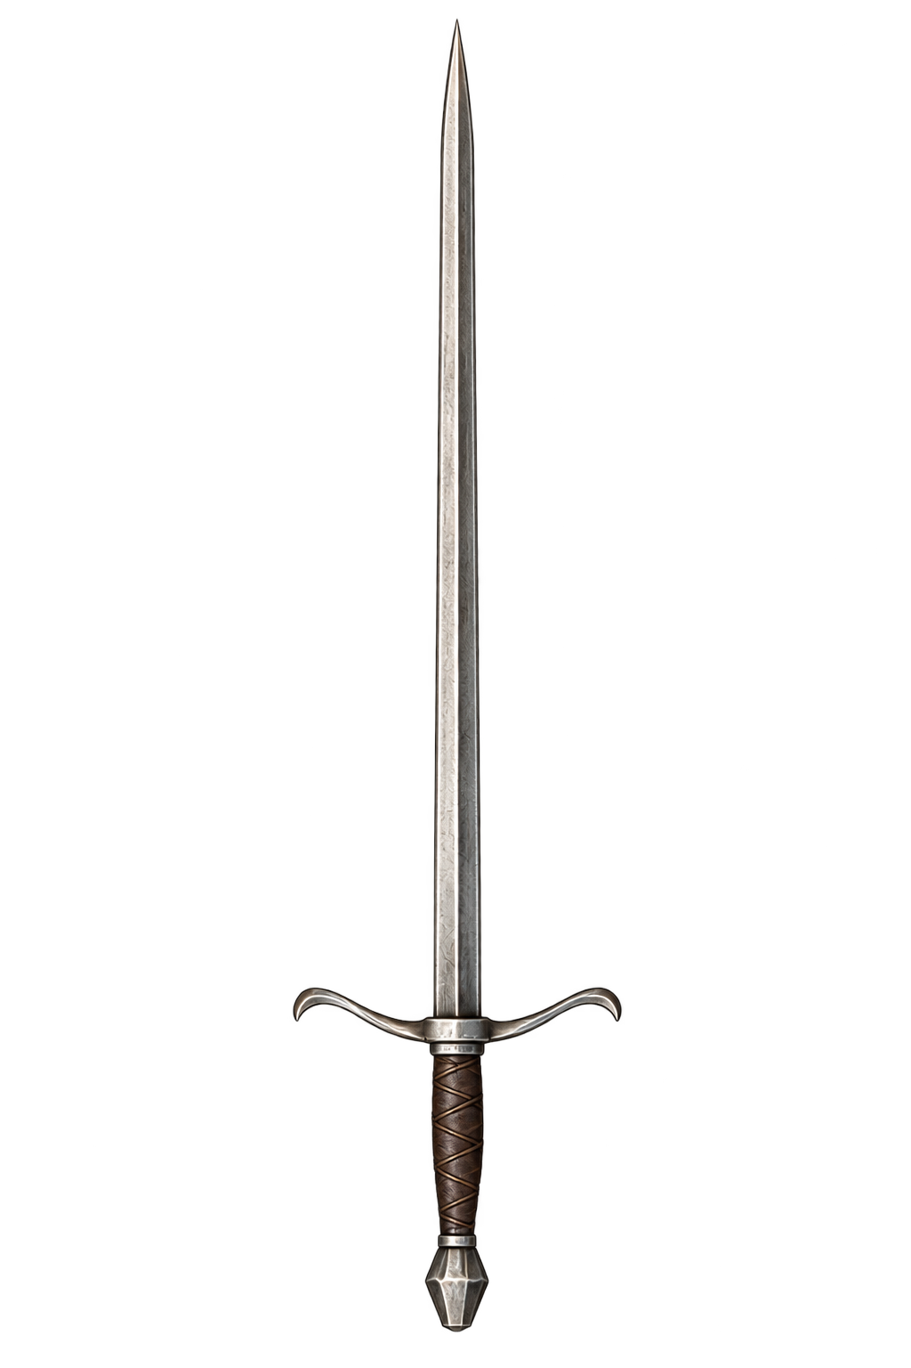
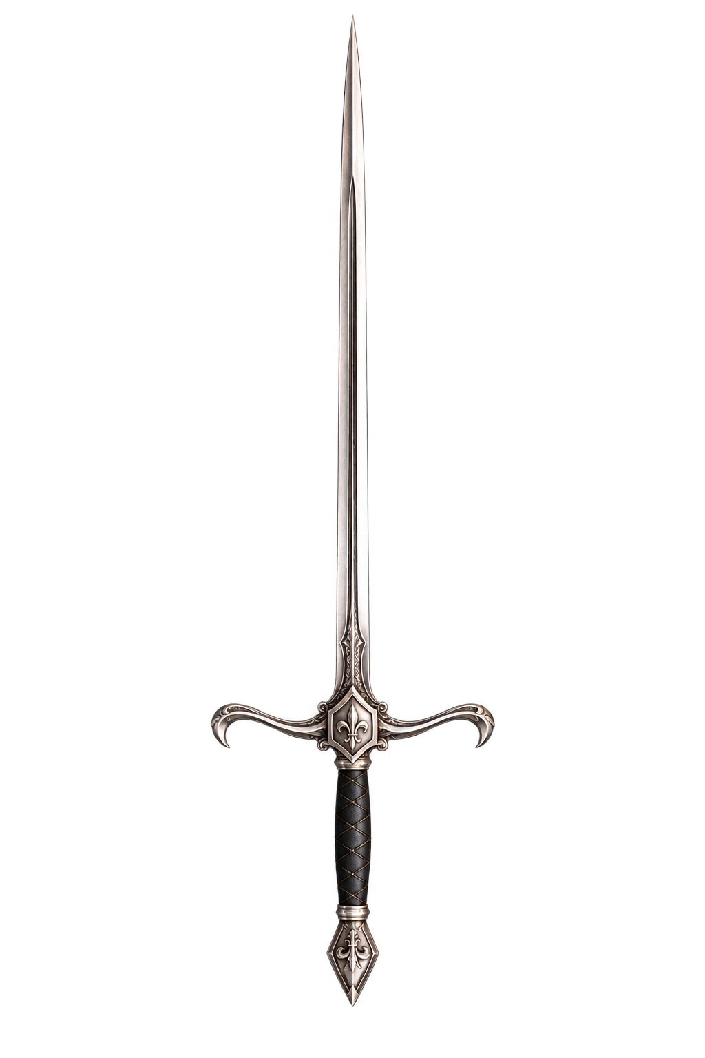
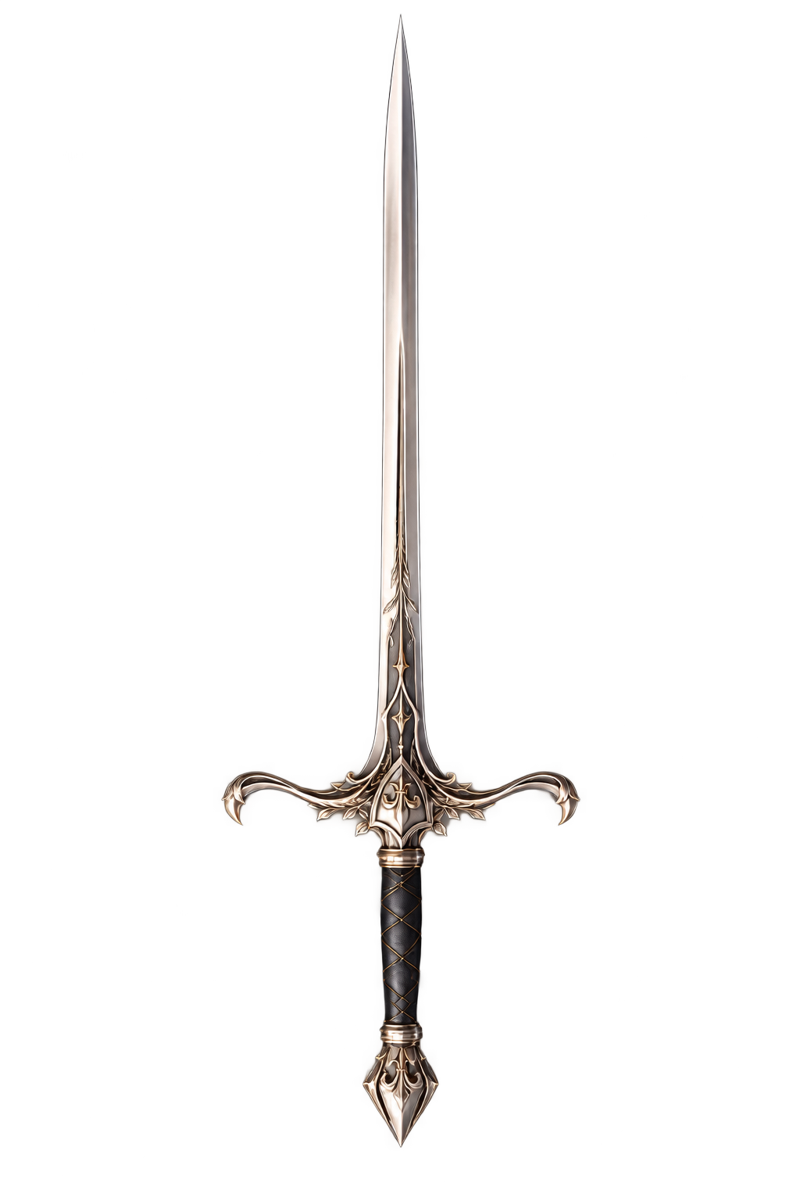
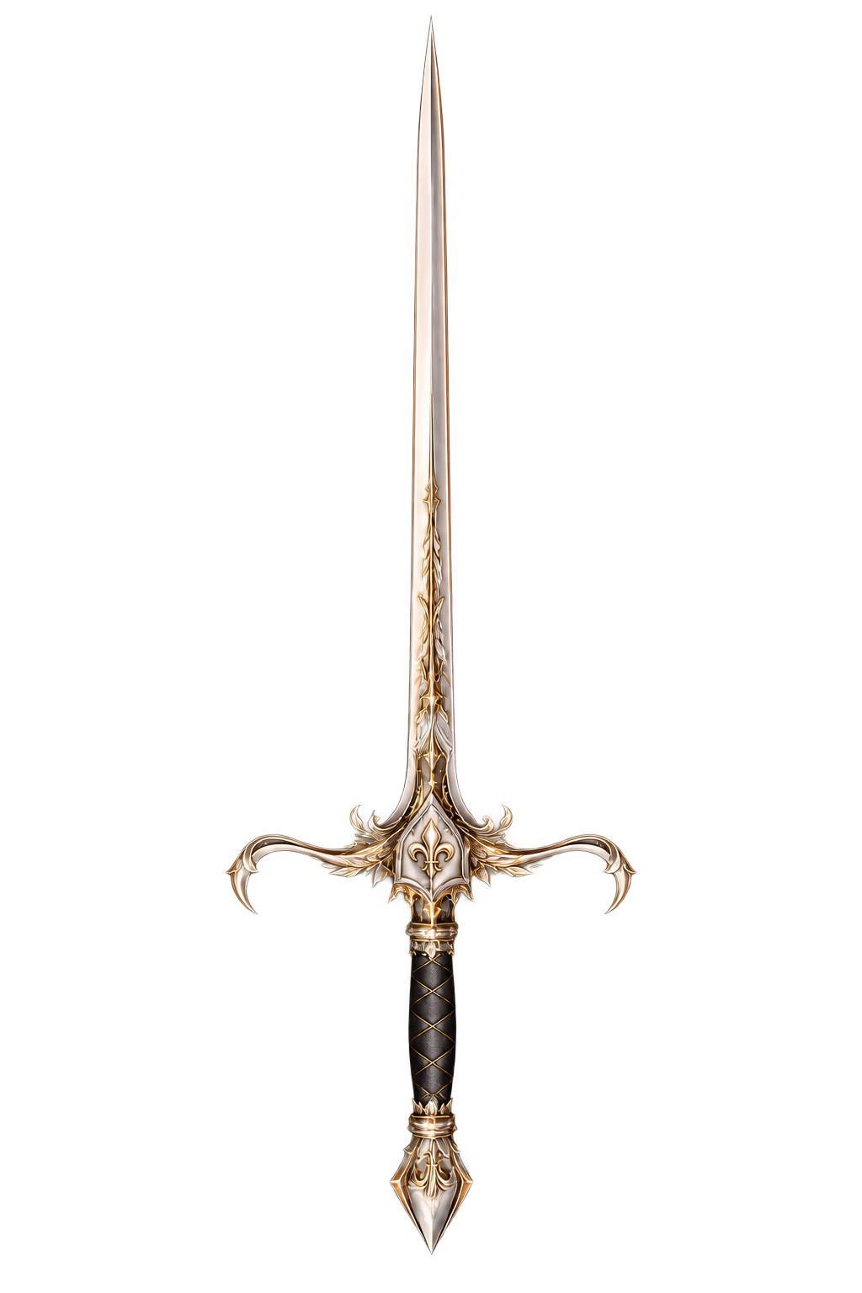
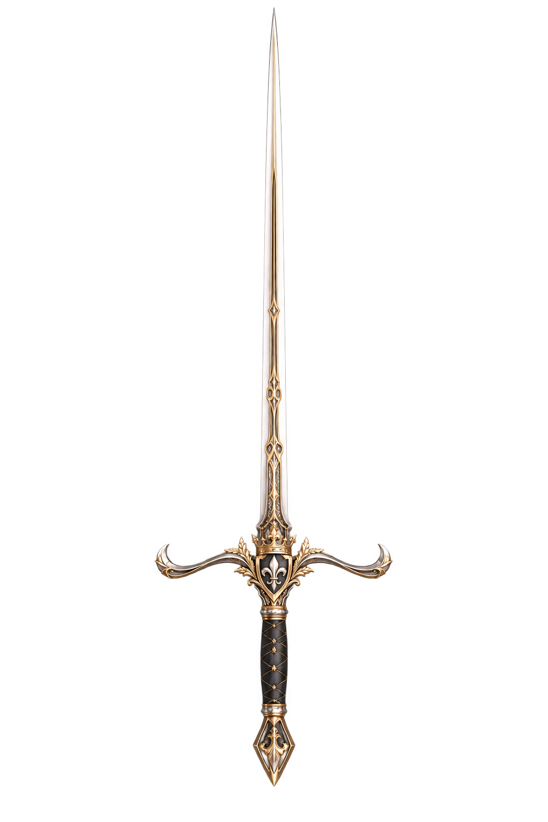
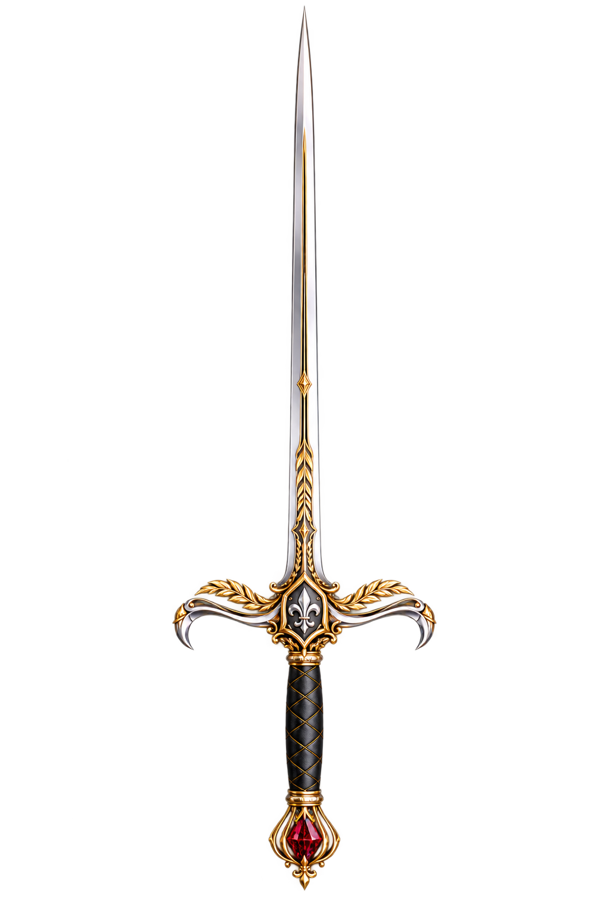
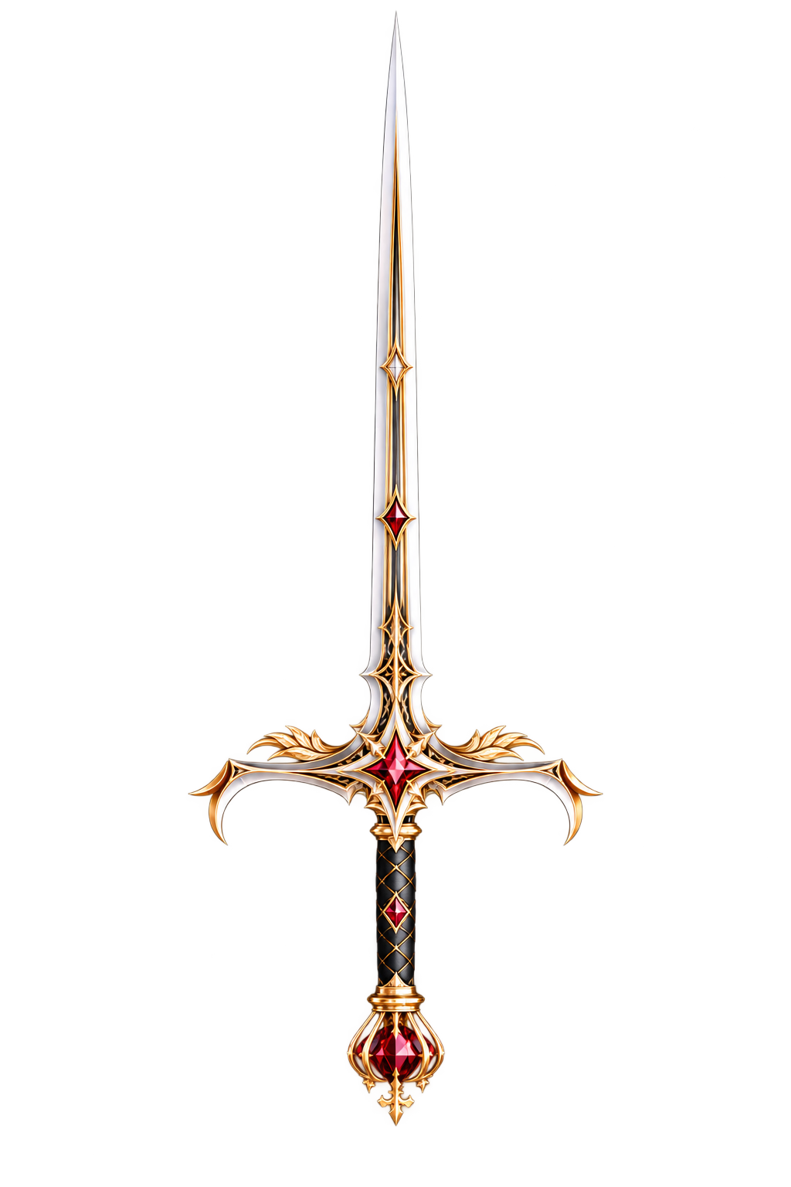
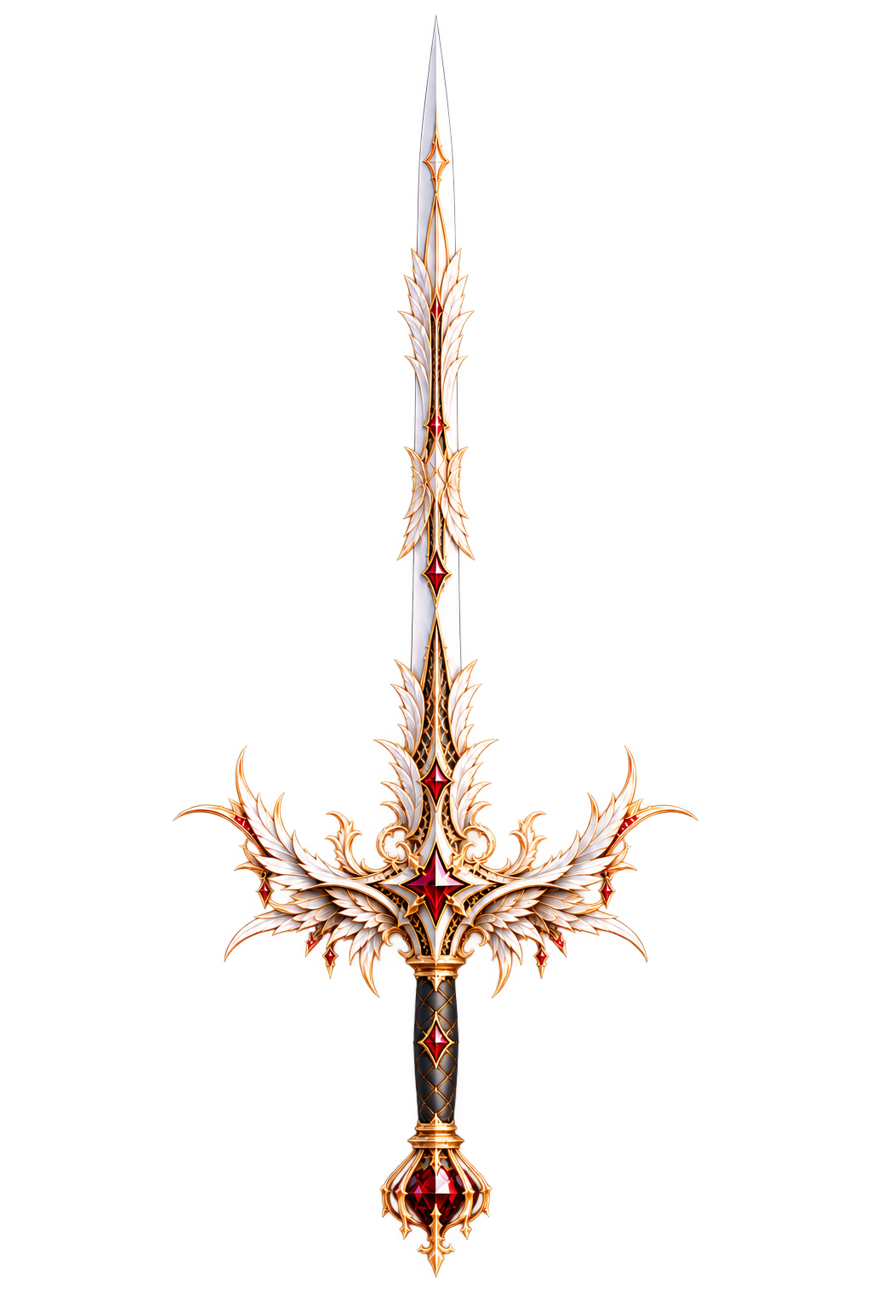
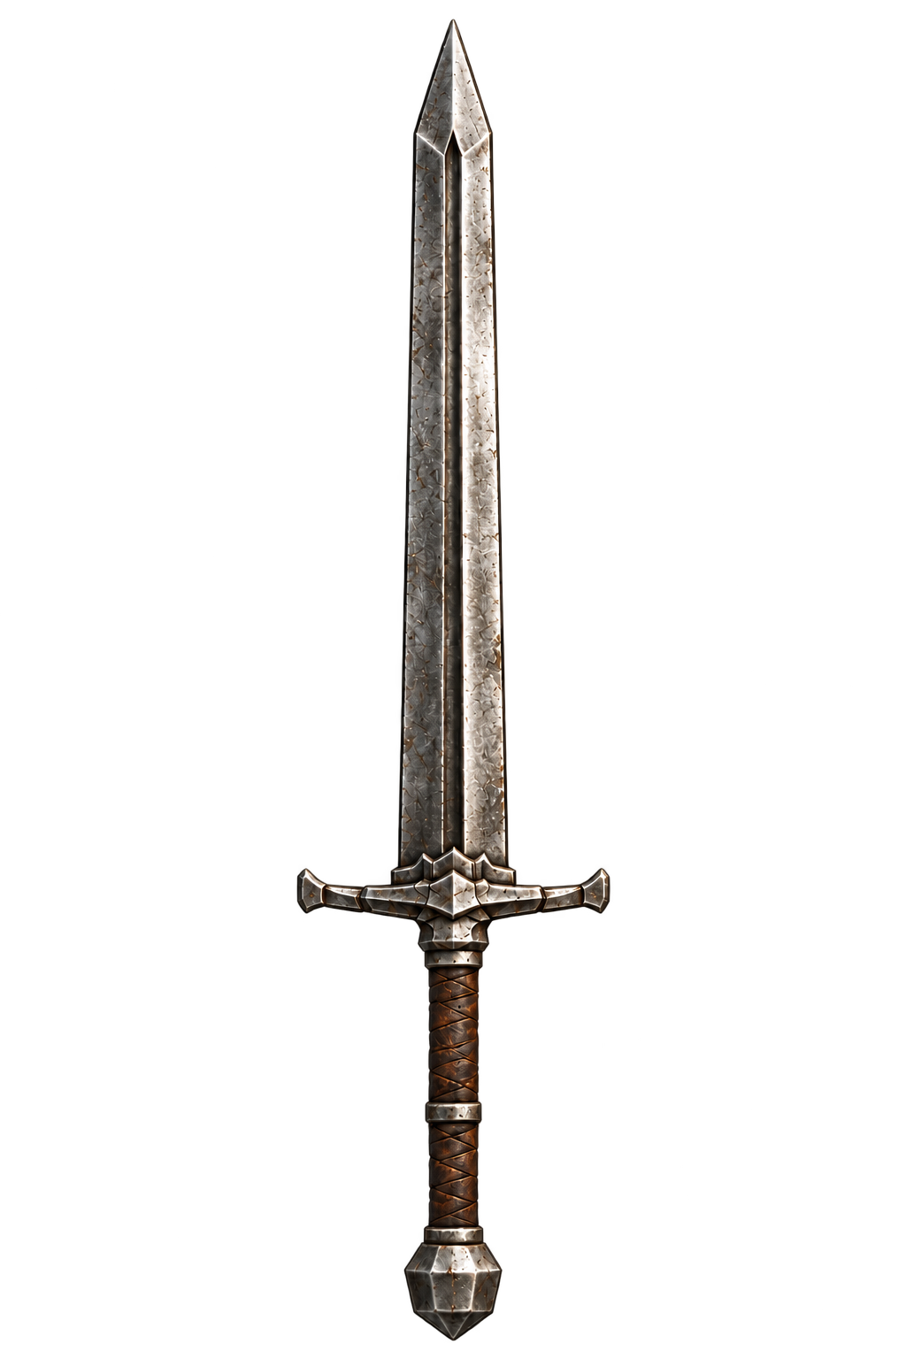
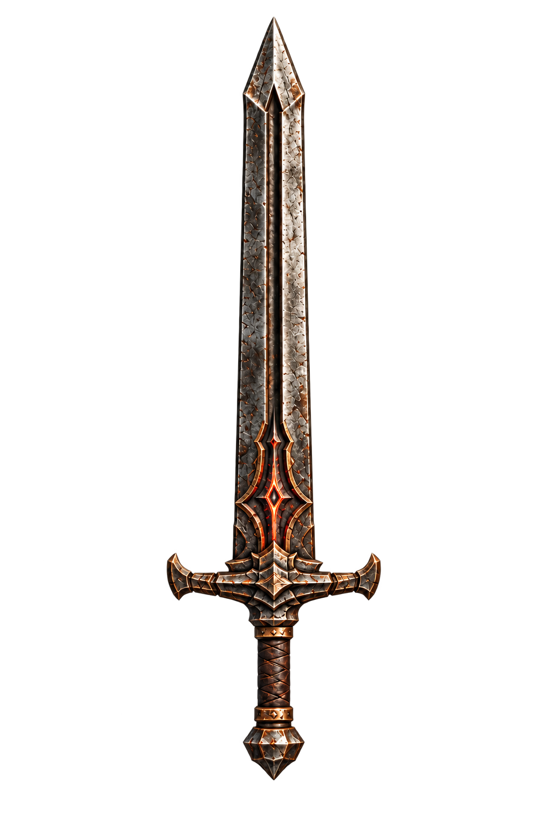
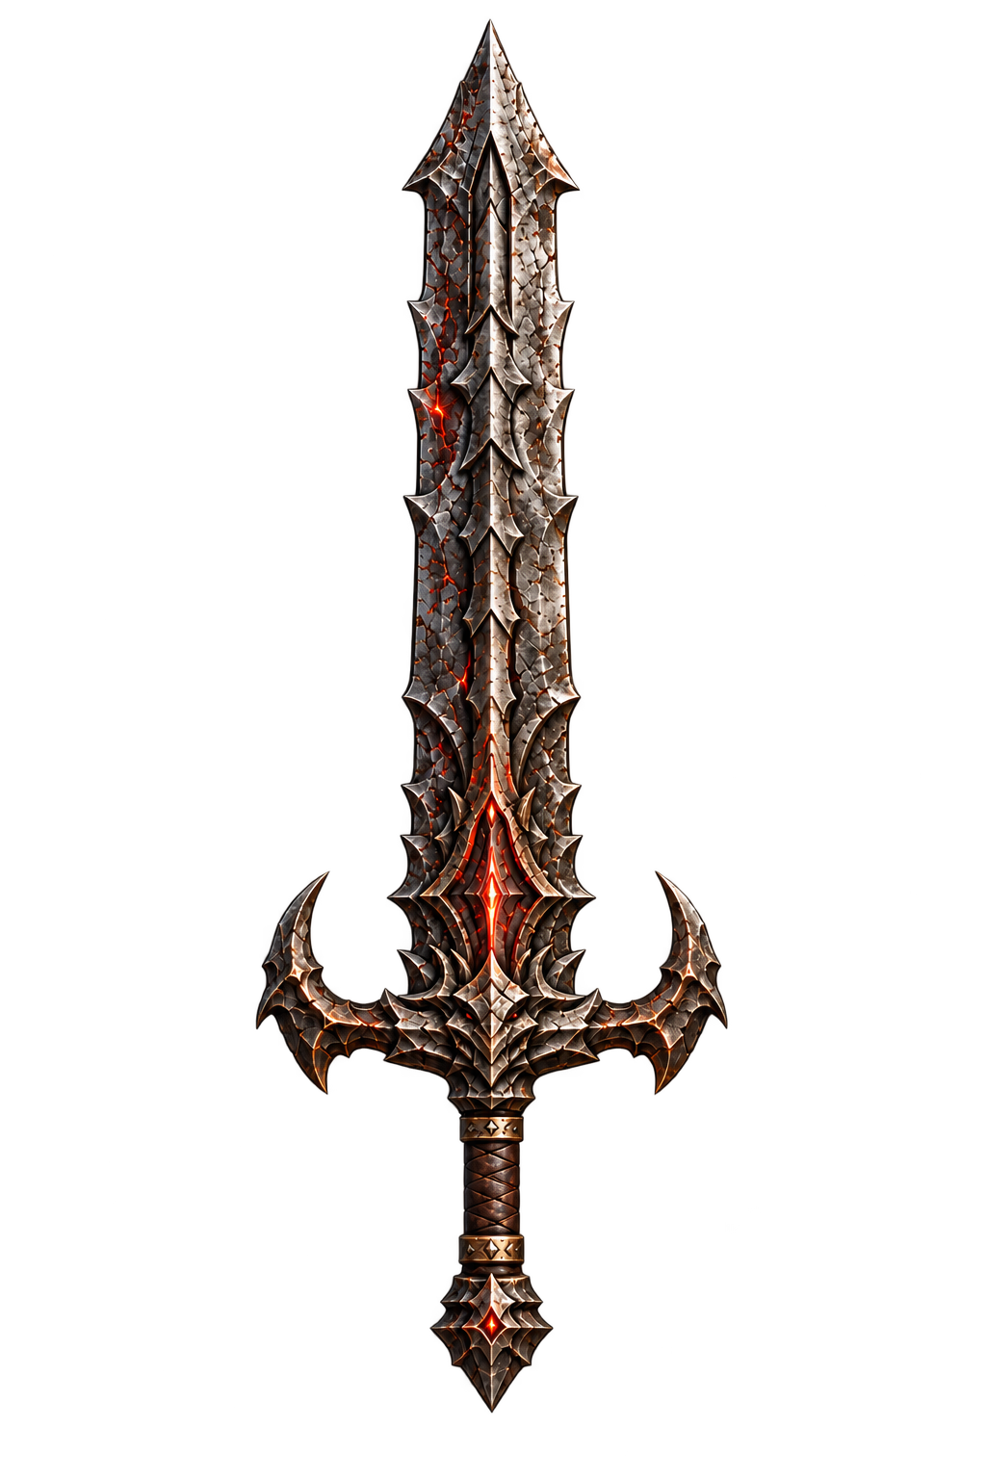
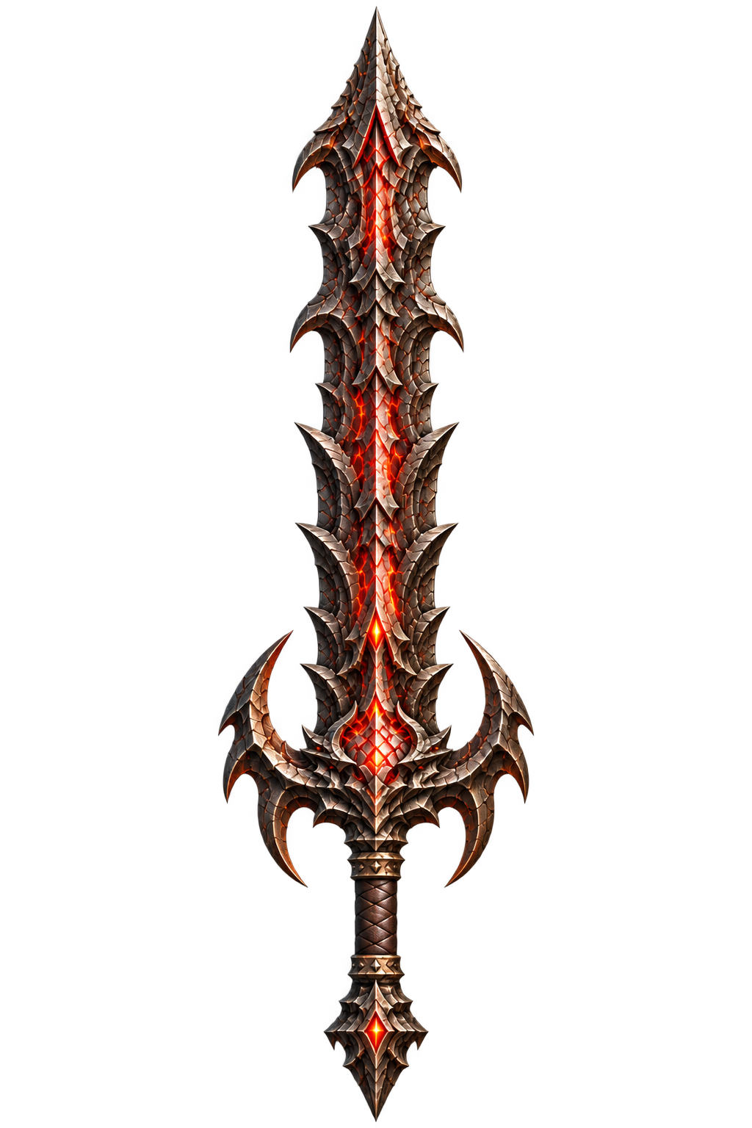
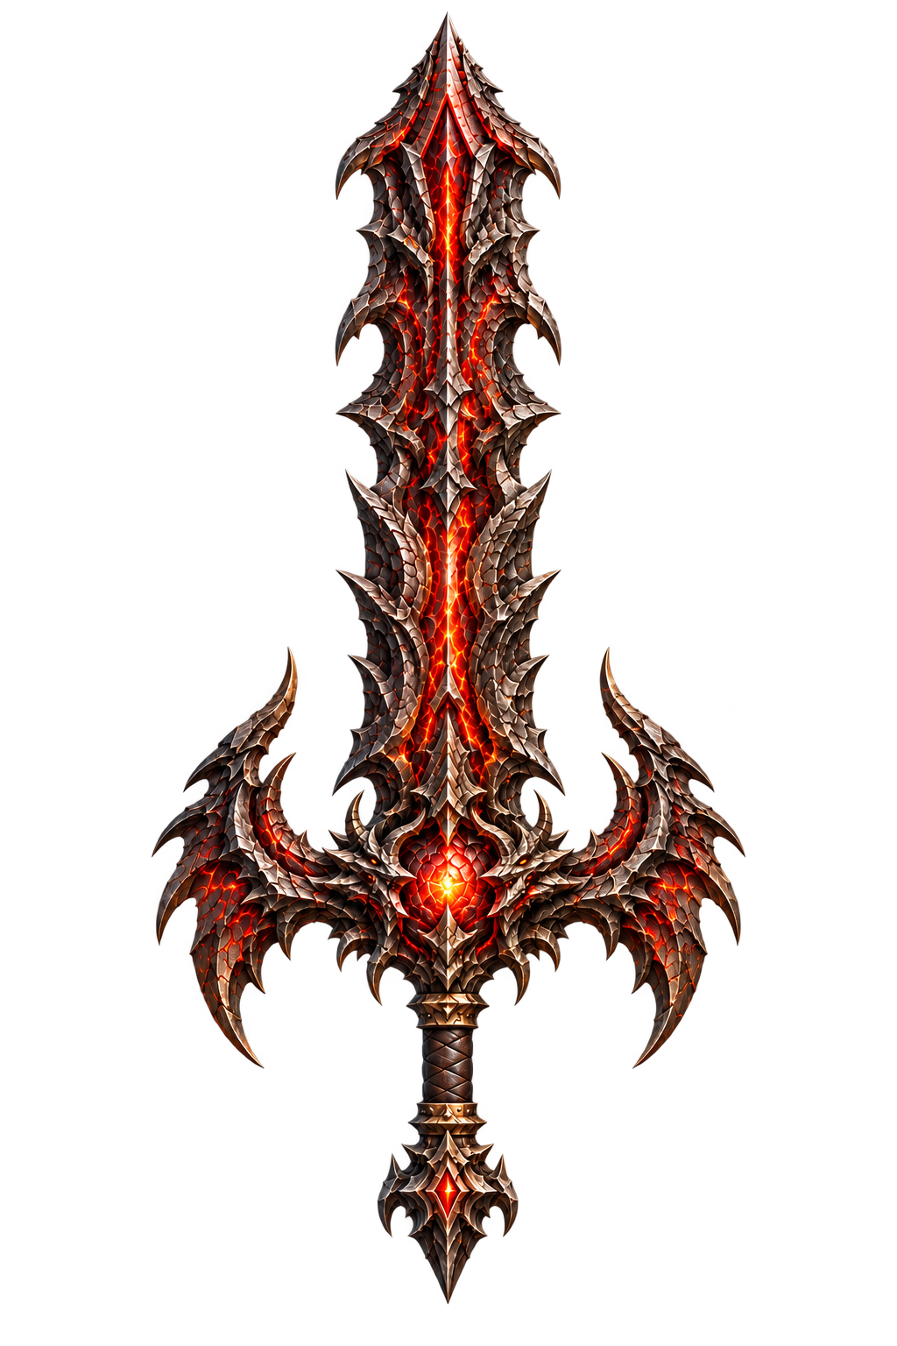
How the weapons change
These are the different looks you unlock as you level up.
Knight Sword
Starting weapon
Final +80 Max +90
+0
+10
+20
+30
+40
+50
+60
+70
+80
Rapier
30% chance at +5
Final +70 Max +80
+5
+10
+20
+30
+40
+50
+60
+70
Greatsword
30% chance at +10*
Final +60 Max +70
+10
+20
+30
+40
+50
+60
*Only Knight Swords can change at +10. Each check happens once. A new type stays fixed.
03
Notes:
Timing: about 45 seconds.
Here you can see how each weapon changes. Every sword starts as a Knight Sword. The first time it reaches or passes level five, it has a thirty percent chance to become a Rapier. If it stays a Knight Sword, it gets another thirty percent chance to become a Greatsword at level ten. Each check happens only once. A successful change starts the Rapier at five or the Greatsword at ten. After that, the weapon type stays fixed. The last pictures show the forms that can become NFTs.
Sources: assets/3d/sword-tiers.json, assets/3d/sword-branches.json, backend/game.py, backend/balance.json and README.md. Original artwork: assets/display/BasicSword, KnightSword, Rapier and Greatsword. Each displayed level is a visual stage, not every possible upgrade level. Checks occur on first reaching or crossing a threshold. Failed checks cannot reroll after downgrades, and successful mutation resets the level to the branch threshold.

Slide 4
How the game is built
The server runs the game. Smart contracts handle NFTs and payments.
Part | Built with | What it does
Game screen | React + Three.js | Shows the game and connects your wallet
Game server | FastAPI + SQLite | Saves progress, game gold and reward mail
Blockchain | Solidity contracts | Tracks NFTs, trades and deposited ETH
We wait for the network’s final confirmation before adding rewards.
After a restart, the server picks up where it stopped.
04
Notes:
Timing: about 40 seconds.
There are three main parts. The frontend is what you see and use in the browser. The server handles the game rules and saves your progress and gold. The smart contracts keep track of NFTs and handle trades and test ETH. The server reads events from those contracts. It waits for the network’s final confirmation before adding gold or sending rewards. It also remembers where it stopped, so a restart doesn’t mean starting over.
Sources: README.md, architecture, listening and recovery sections. chain/contracts/ForgeOfFate.sol, ForgeStaking.sol and ForgeRecharge.sol. chain/链上监听与恢复.md.

Slide 5
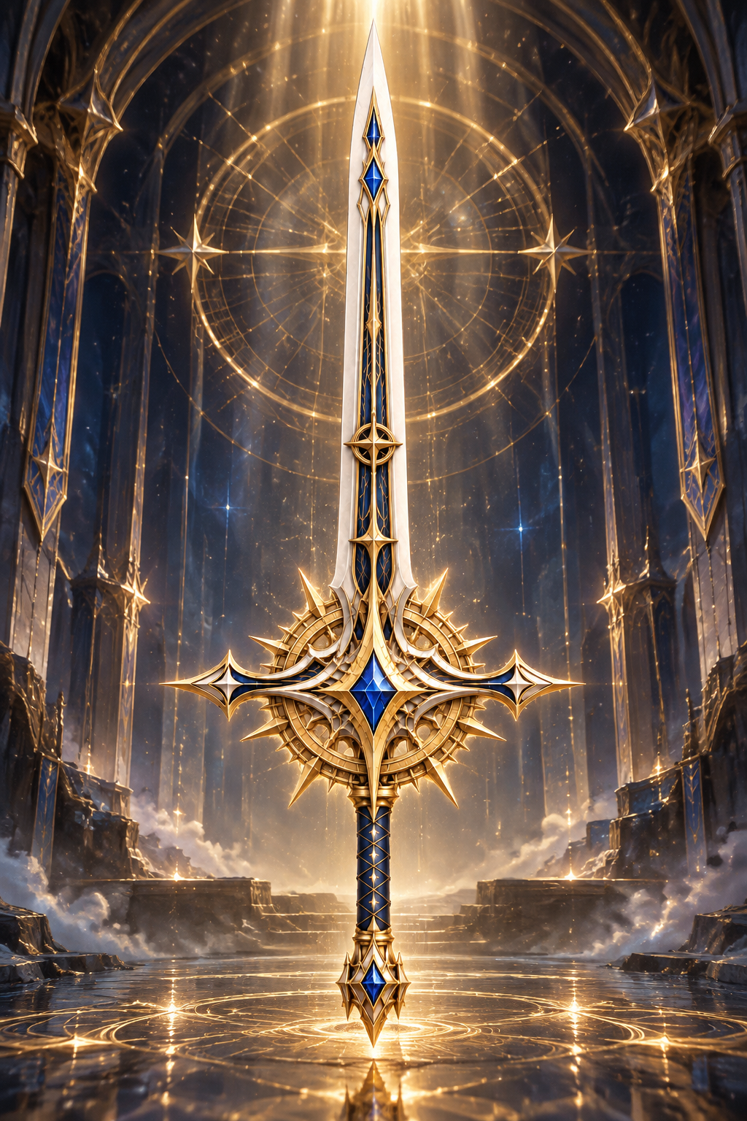
Turning weapons into NFTs
Reach the final form to mint an NFT
Knight Sword | Rapier | Greatsword
+80 | +70 | +60
01 Make it an NFT
Keep it in your wallet, or put it up for sale.
Once sealed, it can’t be upgraded again.
02 Buy and sell
The buyer gets the NFT.
The seller gets a message in the game.
05
Notes:
Timing: about 40 seconds.
You can make an NFT once your weapon reaches its final form. The required levels are eighty, seventy and sixty for the three types. First you seal the weapon, so you can’t upgrade it anymore. Then you mint it into your wallet. You can keep it there or put it up for sale. After a sale, the buyer gets the NFT, and the seller can withdraw the payment. The game also sends the seller a message.
Sources: README.md, NFT and trading rules. chain/contracts/ForgeOfFate.sol. Original visual: assets/NFT_Pic/sword.png.

Slide 6
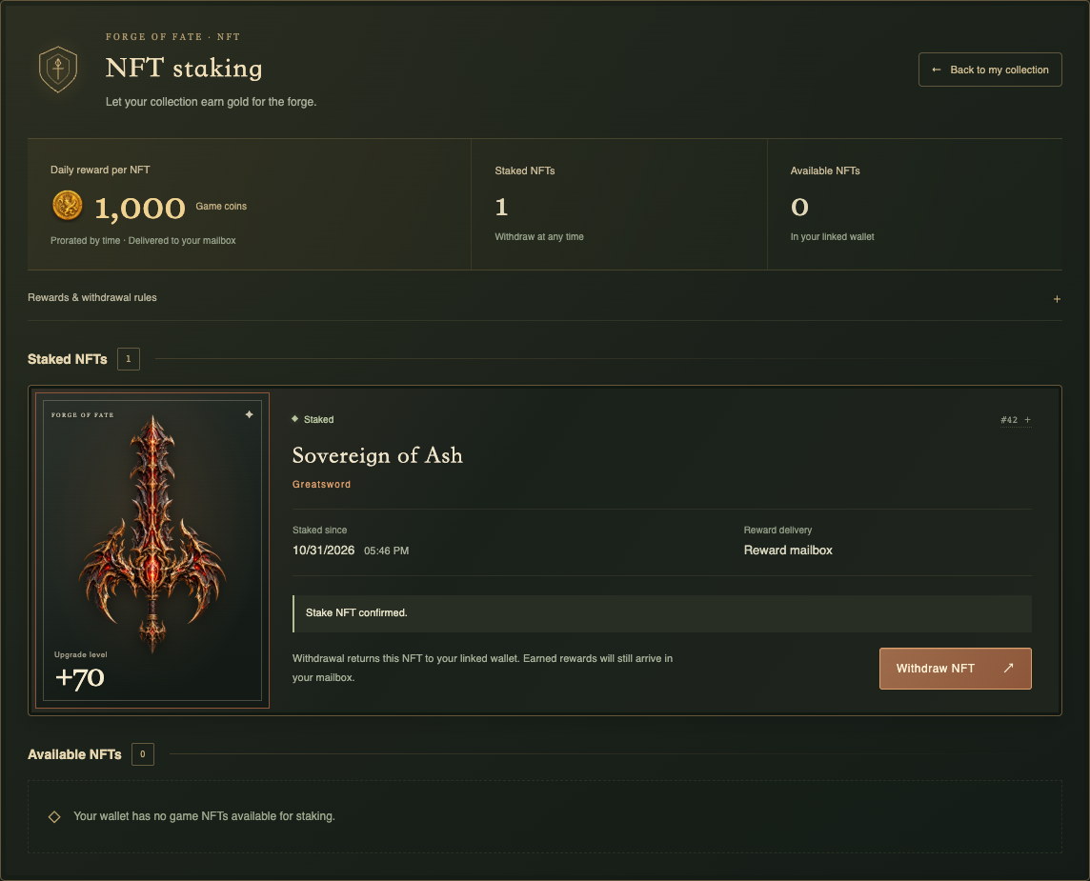
Stake an NFT to earn game gold
1,000
game gold per NFT per day
Based on time staked each UTC day
Two steps to stake
Approve the NFT, then stake it.
Rewards start after the second step.
Take your NFT back anytime
The NFT goes back to your wallet.
Collect your gold from the mailbox.
06
Notes:
Timing: about 45 seconds.
If you keep an NFT, you can stake it from inside the game. First approve it, then confirm the stake. Approval by itself doesn’t earn anything. Our test reward is one thousand gold for a full day. Shorter periods earn less, based on time staked during each UTC day. Rewards arrive in the game mailbox after the day ends and the network gives final confirmation. You can collect one or all of them. You can take the NFT back anytime. The server records each reward and each claim, so a restart or another click won’t give you the same gold twice.
Sources: README.md, staking and mailbox sections. docs/质押合约.md and docs/奖励邮箱.md. Screenshot: .local/ui-previews/staking-panel.png, controlled interface test capture, not proof of a live Sepolia withdrawal. The daily reward is a provisional test parameter.

Slide 7
Buying game gold
0.01
10,000
=
Sepolia test ETH
game gold
Top up your gold
Admin withdrawals
Pay test ETH through your wallet.
After final confirmation, the server
adds the gold once.
The main admin can add or remove
other admins. All withdrawals go
to the same project wallet.
These are test amounts. You can’t swap game gold back for ETH.
07
Notes:
Timing: about 40 seconds.
You can also buy game gold with test ETH. Right now, zero point zero one ETH gives you ten thousand gold. The contract records the payment, and the server adds the gold after final confirmation. The main admin can add or remove other admins. They can withdraw ETH, but it always goes to the same project wallet. These are test amounts, and we still need to balance the economy. Game gold can’t be swapped back for ETH.
Sources: README.md, recharge and administrator withdrawal rules. chain/contracts/ForgeRecharge.sol. backend balance and recharge configuration. Deployed recharge manifest: deployments/recharge-sepolia-demo.json.

Slide 8
What we’ve tested
All three contracts are running on Sepolia.
Where we tested | What we checked
On Sepolia | Minting NFTs, buying with a second wallet, staking, and getting gold from a top-up
Local tests | Repeated claims, server restarts, taking NFTs back, admin withdrawals and removing access
Still to test on Sepolia | Daily reward mail, taking NFTs back, admin withdrawals, and adding or removing admins
Demo: forge a sword, show an NFT, then open staking and the mailbox.
The README shows how to set up and run the project.
08
Notes:
Timing: about 40 seconds.
All three contracts are running on Sepolia. We’ve already tried minting, buying between two wallets, staking, and topping up gold. We’ve also used a local test chain to check repeated claims, server restarts and admin permissions. The README explains how to set up and run the project. That’s our game. Thank you.
Sources: README.md, current status and testing sections, updated 2026-11-02. chain/测试与交易审查记录.md, dated test records with later README status taking precedence. Public deployment manifests: deployments/sepolia-demo.json, staking-sepolia-demo.json and recharge-sepolia-demo.json. This slide does not claim a production security audit or completed live acceptance for pending items. Use a prepared reward email during a five-minute demonstration because real UTC-day settlement is asynchronous.

